Slide 1
Recommending Anime
Through K-Means Clustering

Slide 2







What is anime?
Sci-Fi
Adventure
Horror
Sports
18+
Shounen
Shoujo
Romance
Hentai

Slide 3
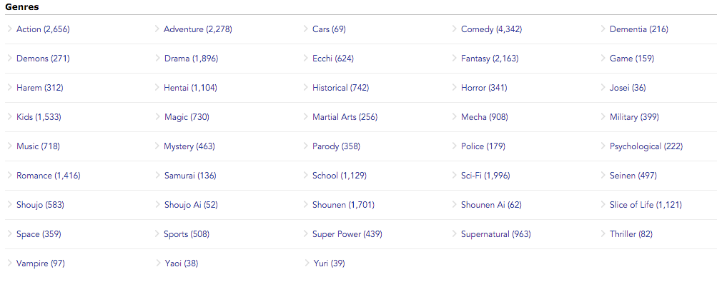

Slide 4
Can we also group anime according to their Descriptions?

Slide 5

Method
Remove stop words specific to anime
K-means clustering
Tf-Idf Analysis

Slide 6
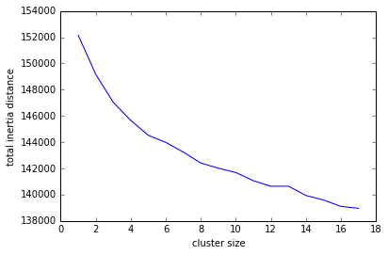
Clusters
Total inertia for various cluster sizes
9 clusters
0: earth, space, planet, alien, pilot
1: father, family, mother, live, life
2: world, mysterious, girl, know, power
3: school, high, high school, student, girls
4: love, girl, fall love, fall, day
5: make, girl, work, come, time
6: music, song, single, band, produce
7: power, war, fight, city, battle
8: team, match, play, girls, join

Slide 7

Flask Application

Slide 8
Thank you!

